Slide 1
Statistical Data Analysis Project
By Christopher Wallis and Adam Raddant

Slide 2
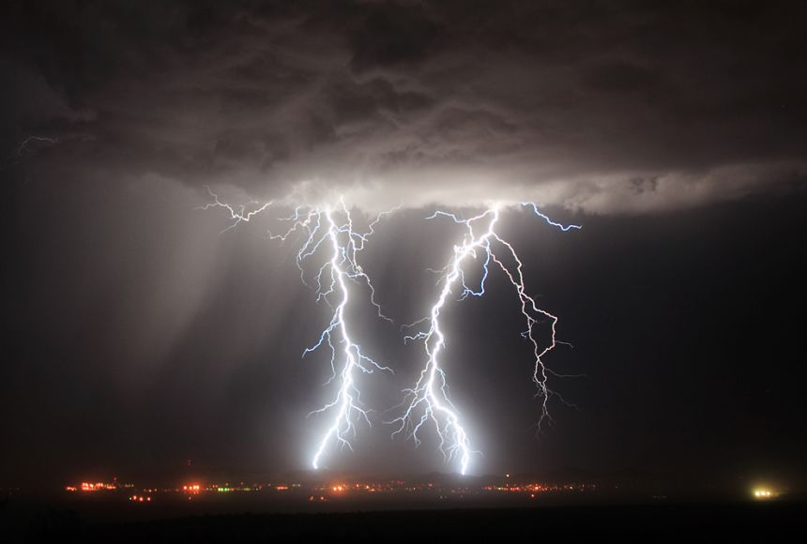

What Is In Our Dataset?
For our project we decided to analyze meteorological patterns depending on the month and the year that it was recorded in Minnesota. We also decided to match the months and years with the CO2 levels during that time period.

Slide 3
Where Did We Get Our Data?
For the meteorological data, we gathered the information from the website National Centers for Environmental Information where the data collection stems from the University of MN St Paul.
(1)

Slide 4
Where Did We Get Our Data?
For the information relating to the CO2 levels in the atmosphere during certain periods of time, we got our data from the website of NOAA Global Monitoring Laboratory which is an official government website.
(2)

Slide 5
What Is In Our Dataset?
Time - We have two variables to determine the time period the data is referring to, one variable for the month and another for the year. This dataset records each month from 1972 to 2024.
Precipitation - We have one variable for the measured rainfall recorded in inches. The way the data is recorded is slightly vague but we believe it to be the total rainfall for the corresponding month.
Average Temperature - We have one variable for the measured temperature recorded in Celsius.
CO2 - We have one variable for the measured CO2 levels in the atmosphere recorded in ppm (parts per million)

Slide 6
Why Did We Choose This Topic?
We chose this topic because we were kind of interested in how the information we gathered related to “Common Knowledge” such as weather patterns. We were also interested in how the data we gathered relates to what we are often told by many media outlets and well known scientists regarding global warming. This topic is also well researched which made it easier to find data for each month and each year in the range we chose.

Slide 7

Analyzing Precipitation Data
The following slides will work on using basic methods to analyze the precipitation/rainfall patterns recorded within the dataset for the state of Minnesota.

Slide 8
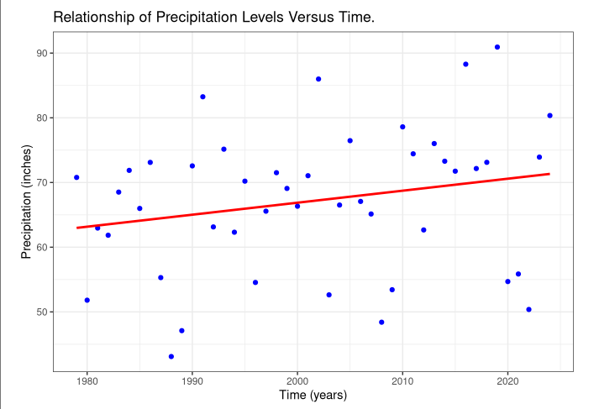
This is a very basic scatter plot that depicts the precipitation levels over time in Minnesota. This graph shows us that it can appear as though it rains more often as time passes.

Slide 9
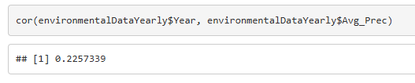
Correlation Check
We ran a quick check for the correlation coefficient between these two variables and found a weak positive relationship between the time and the average precipitation.

Slide 10
Why Does It Seem Like It’s Raining More Often?
This is a complicated question to answer that many scientists will often disagree on.
If you google this question, Google will tell you that it’s related to climate change but many scientists will disagree and tell you that the data is inconclusive.
If you are interested, the following link takes you to a UK government website that explains some of the known and uncertain effects of climate change.
https://weather.metoffice.gov.uk/climate-change/effects-of-climate-change

Slide 11
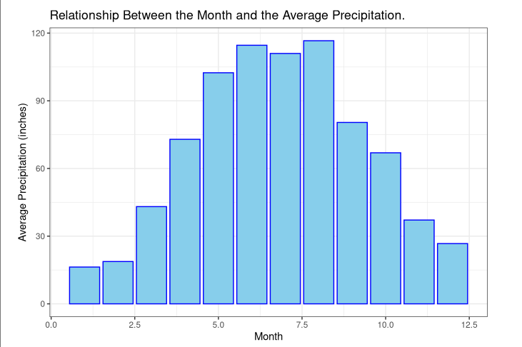
This is a histogram that demonstrates the
average precipitation totals for each month. From this graph we can see that it rains more often during the Summer months. This is pretty obvious due to our “Common Knowledge” of Summer.

Slide 12

Analyzing CO2 Data
The following slides will work on using basic methods to analyze the CO2 patterns recorded within the dataset for the state of Minnesota.

Slide 13
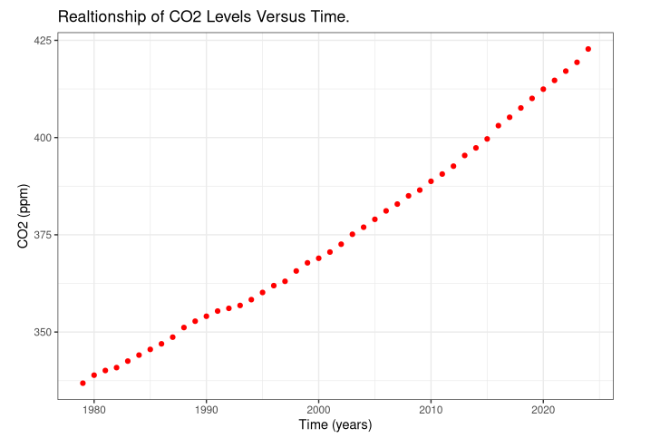
This is a scatter plot that demonstrates the CO2 levels in the atmosphere over time. This graph shows us that CO2 levels are rising pretty consistently each year. This coincides with what we’re often told by many modern scientists that are warning us of global warming.

Slide 14
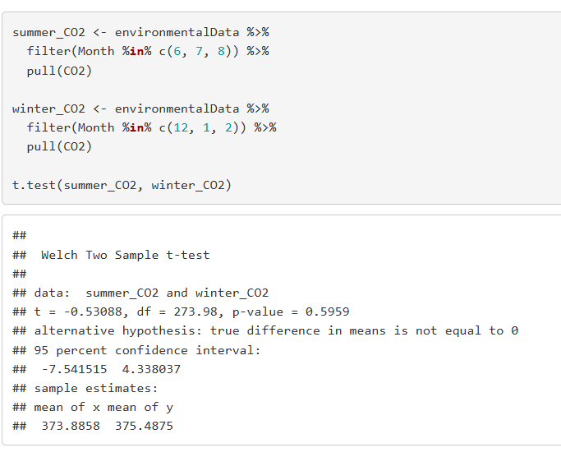
Hypothesis Testing
Because we were curious, we ran a t-test to check whether or not there is a statistical difference between the CO2 levels in Summer and Winter. We can see that the p-value is greater than 0.05, so we fail to reject the null hypothesis.

Slide 15
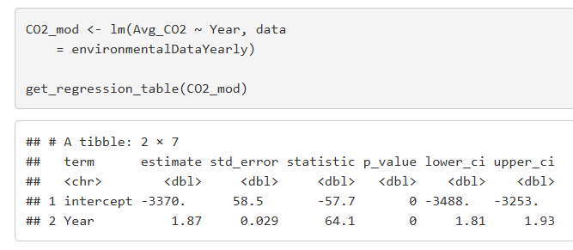
Linear Regression
The following regression table demonstrates the relationship between the time and the CO2 levels. The intercept being a negative 3370 for the CO2 levels would be impossible because you can’t really have a negative CO2 level. This tells us that the current rate of change hasn’t always been as it is and that it must have increased at a slower rate in the past and using regression between these variables doesn’t help us much.

Slide 16
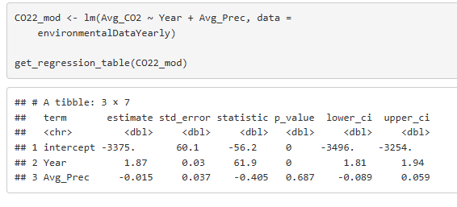
Linear Regression
Interestingly enough, when we use the multi-linear regression model for the CO2 we can see that the intercept is still really messed up but also that the coefficient for the Avg_Prec isn’t too closely related according to the model.

Slide 17
Why is the Regression Intercept Negative?
One very likely possibility is that we messed up when analyzing the data (everyone makes mistakes).
As previously mentioned, another good guess would be that the rate of change has increased more recently in history. When we researched into this we found that in the past 60 years, the CO2 in the atmosphere has increased 100 times faster than it did during the end of the last ice age. This would explain why the intercept was such a large negative number.
(3)

Slide 18
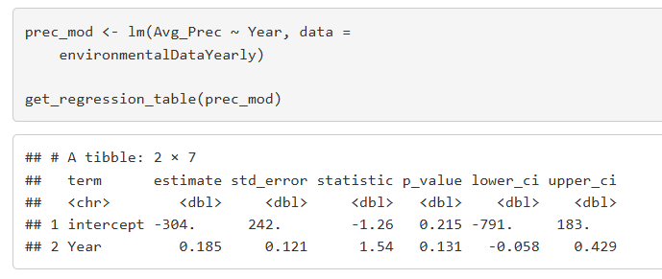
Linear Regression
If we look back at the precipitation data, the following regression table demonstrates the relationship between the average rainfall and the time. Once again, the intercept here is unreasonable and suggests that the current rate of change has increased recently.

Slide 19
Why is the Regression Intercept Negative?
Once again this could have been due to our own human error.
Another likely reason would be that the rate of change has increased more recently in history.
Both rates of change in the CO2 and the Precipitation increases in recent history could suggest that the causes are related but we do not have enough evidence to support either argument with our current knowledge.

Slide 20
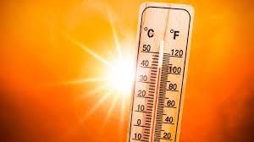
Analyzing Temperature Data
The following slides will work on using basic methods to analyze the temperature patterns recorded within the dataset for the state of Minnesota.

Slide 21
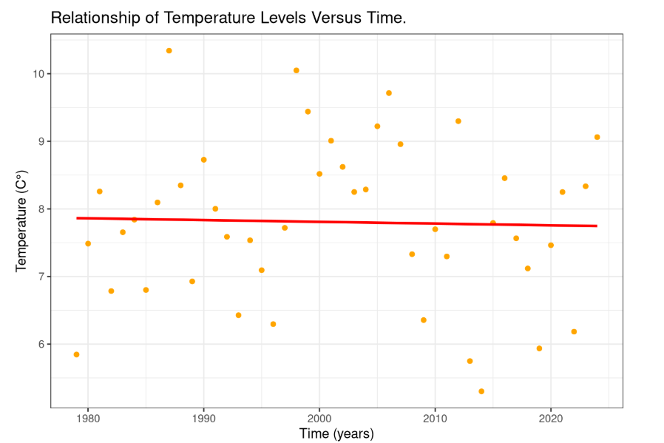
This is a basic scatter plot that demonstrates the temperature levels versus time in Minnesota. The variety in the graph shows that this isn’t an appropriate way to demonstrate the data. This makes sense because we know that temperatures cycle and are drastically different in different months.

Slide 22
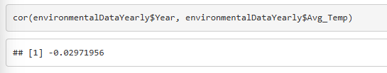
Correlation Check
We ran a quick check for the correlation coefficient between these two variables and found a very weak negative relationship between the time and the average temperature.

Slide 23
Why Is The Correlation So Low?
There is always a chance that we made a mistake in organizing the data.
There is a possibility that it’s just simply difficult to measure the temperature change over time due to the fact that it changes drastically throughout the year.
There’s also the option that the temperatures just doesn’t really change that much over time.

Slide 24
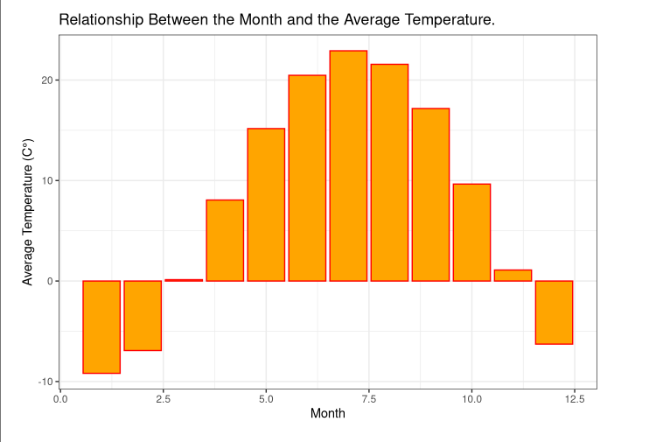
This is a histogram that demonstrates the average temperature of each month. This graph tells us that it is much hotter in the Summer months than in the Winter. Once again, this is pretty common knowledge but confirms what we already know.

Slide 25
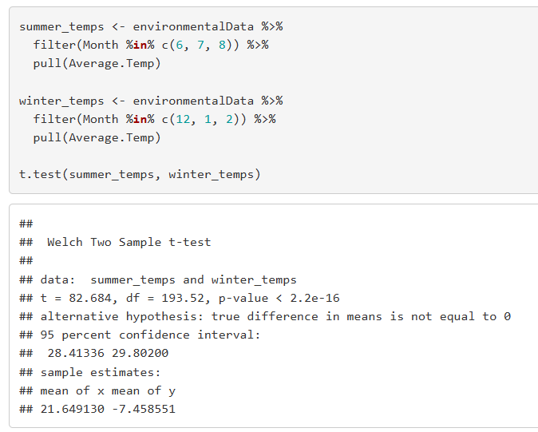
Hypothesis Testing
We ran a t-test to check whether or not there is a statistical difference between the temperature levels in Summer and Winter. We can see that the p-value is less than 0.05, so we fail to reject the null hypothesis. Once again, this is pretty obvious according to “Common Sense”

Slide 26
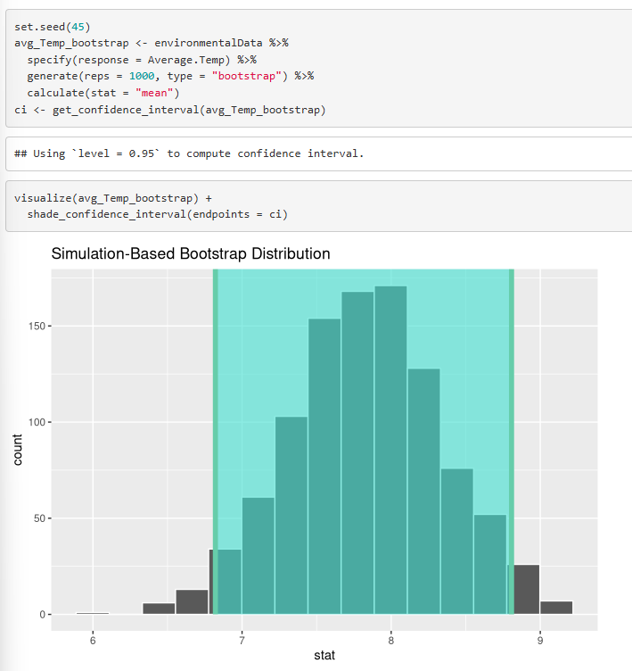
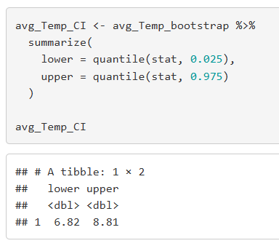
Lastly, we ran a bootstrap sampling for the temperature variable and found the 95% confidence interval.

Slide 27
Citations
https://www.ncei.noaa.gov/access/search/data-search/global-summary-of-the-month
https://gml.noaa.gov/ccgg/trends/gl_data.html
https://www.climate.gov/news-features/understanding-climate/climate-change-atmospheric-carbon-dioxide

